Slide 1
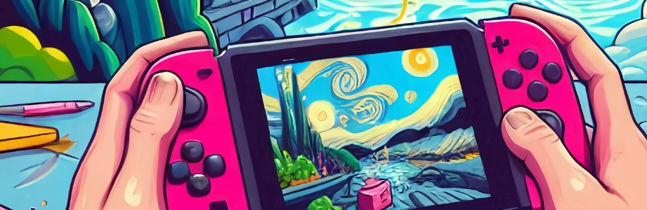

Games with Culture
Using Cultural Heritage as Game-Making Material
DiGRA 2026 Conference
14–18 June 2026
Maynooth University, Ireland
Stanisław Krawczyk, University of Wrocław
Rikke Toft Nørgård, Aarhus University
Kim Holflod, Aarhus University, University College Copenhagen
Maarten Groen, Amsterdam University of Applied Sciences
Paula Lopes, Lusófona University

Slide 2
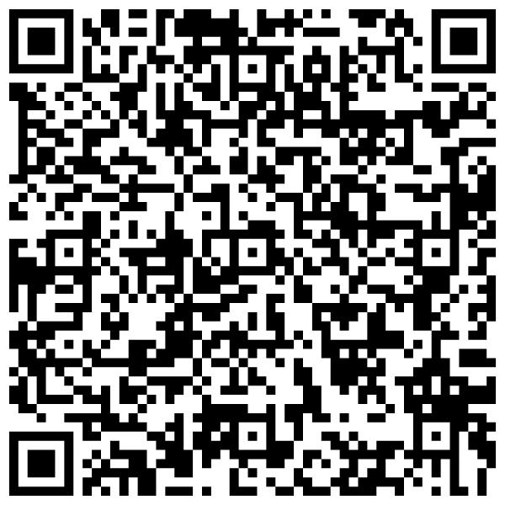
Full paper available online
https://stanislawkrawczyk.pl/ (the slides are also here)

Slide 3
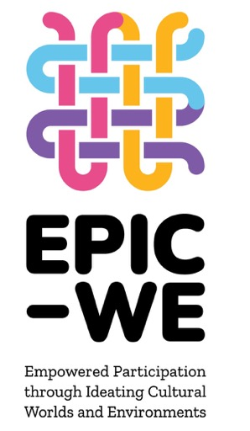
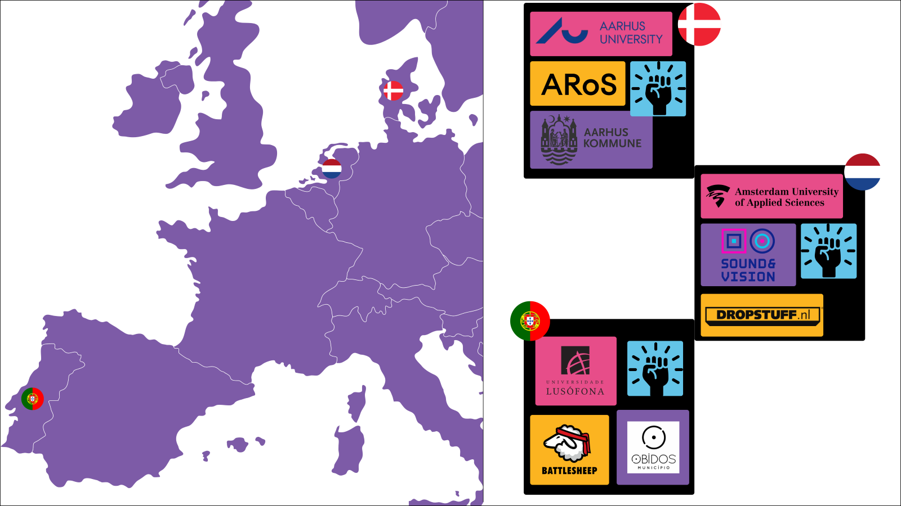

1 Quadruple Helix Cultural Innovation Ecosystem linking
3 QH Cultural Hubs in cross-sector collaboration, innovation, and partnerships through 12 Cultural Game Jams with 400+ youth creating 100+ games through/for culture
Notes:
The project will develop and deliver cultural game jams and games through and for culture as a format to empower young people as co-creators of European culture, equipped with cultural-creative imagination and skills needed to initiate value-driven societal changes through culture-sensitive game-making in quadruple helix systems.
The EPIC-WE project consists of 12 partners that have developed, tested, evaluated 12 Cultural Game Jams involving more than 400 youth co-creating more than 100 games through and for culture and with European values and cultural heritage.

Slide 4
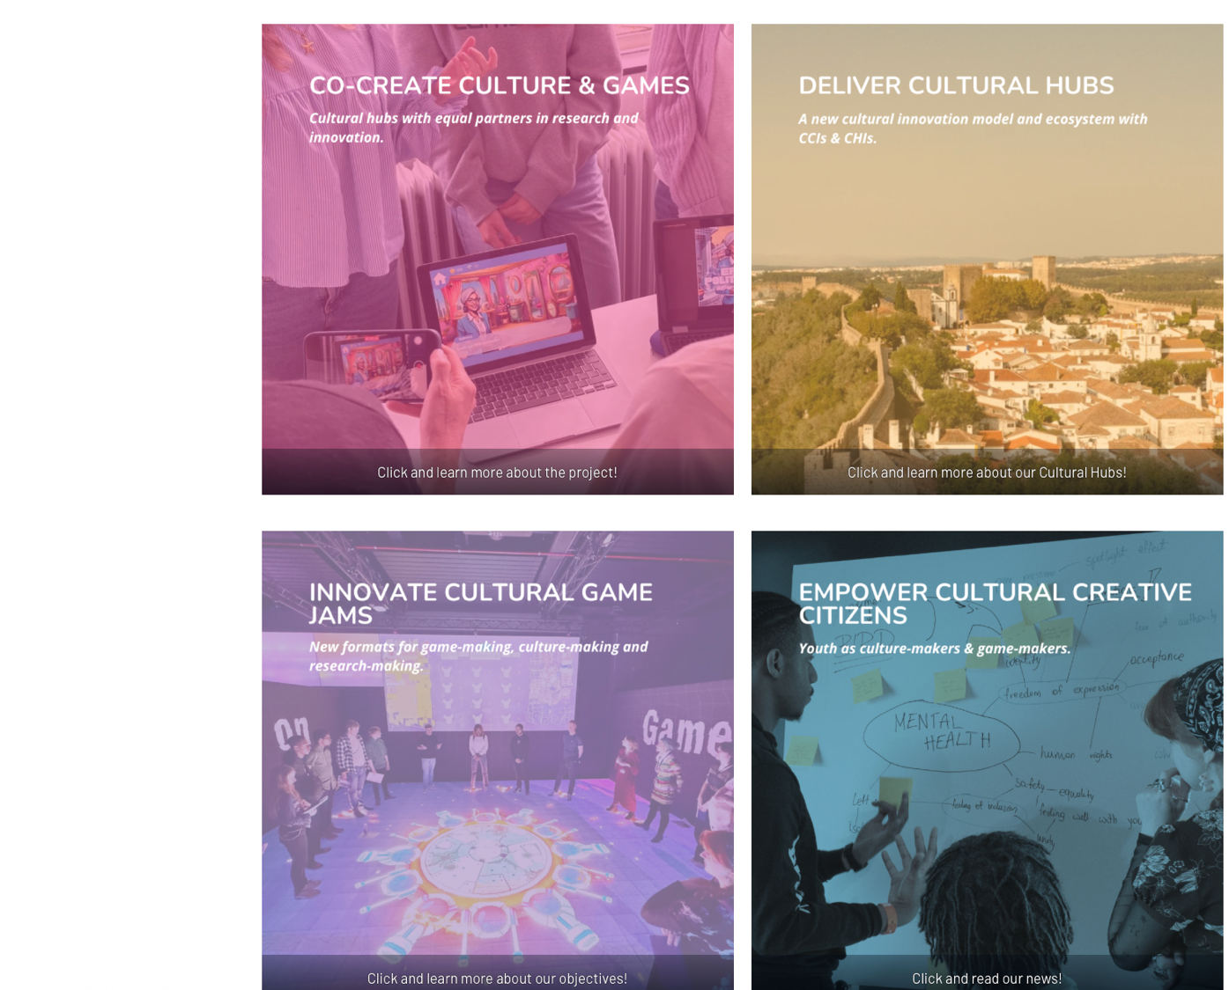
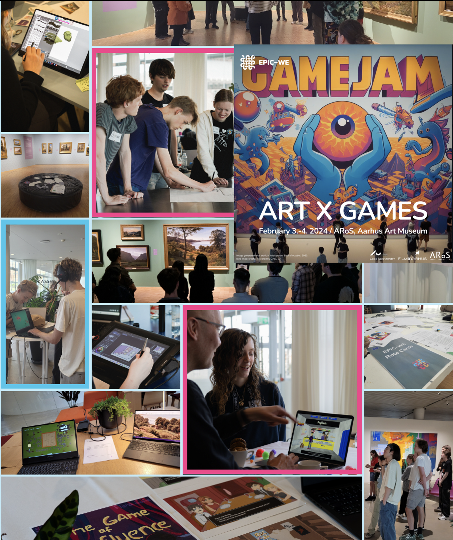
Notes:
The heart of the project has been Cultural Game Jams in cross-sector partnerships empowering youth in shaping futures in games and culture.
Through the Cultural Game Jam format youth engage, create and share their imaginings of and responses to European cultural heritage, values, identities, and themes through creating their own ‘Games through Culture’ and ‘Games for Culture’.
​
EPIC-WE shows cross-sector collaboration around game-making as culture-making can generate games and models for engaging heritage and turn culture into a playground where innovation, heritage and imagination empower each other and youth actively transform, coshape and give voice to the cultural heritage narratives, values and identities we are all part of.​
​
​

Slide 5
GAMES through CULTURE
Games engaging cultural heritage through ‘concrete use’ as a game-making material
GAMES with CULTURE
Prototypes further matured with game studios
Integrating through/for culture
Highlighting cultural game prototypes potentials
GAMES for CULTURE
Games empowered to ‘say something’ about culture / society drawing inspiration from heritage
GAMES as CULTURE
Game-making as culture-making
Games as part of cultural heritage
Games as cultural participation
Notes:
EPIC-WE focus on game-making as a powerful tool for youth participation and cultural transformation.
Key points of games through culture include:
Games through culture utilise cultural heritage as innovative game-making material to enable new aesthetic expressions, actualisations, and remediations of cultural heritage and game design. Cultural Game Jams allow youth to engage directly with tangible cultural heritage to reimagine, remix, and recreate it in the form iof a game
Youth “jam” with cultural heritage—concretely and directly—found within cultural environments such as galleries, libraries, archives, and museums, using the cultural assets they house as materials in their game-making processes.
the emphasis on games through culture highlights youth's deep integration of cultural heritage into their games, serving as a means towards empowered participation in culture.
This approach encourages cultural heritage institutions to invite and enable youth to become culture-makers through being game-makers.
By embracing games as a creative and innovative medium, these institutions foster widened participation and provide opportunities for young people to contribute directly to the preservation, transformation and evolution of cultural heritage.
Cultural heritage institutions broaden their roles beyond curation and exhibition, actively participating in co-creating cultural gameplay interactions and experiences alongside young people.
Key points of games for culture include:
Games for culture engage broader cultural and societal contexts by creating games with and for discussion, cultural transformation, new cultural experiences, and empowered cultural citizenship and belonging.
This approach invites youth to engage directly with intangible cultural and societal issues and existing narratives to showcase how culture or society might be reimagined, remixed, and recreated through games.
And games for culture empower youth to create entirely new ones.
By collaborating with cultural heritage institutions and the creative industries, young people become cultural co-creators, using the medium of games to express their identities and perspectives and address cultural or societal challenges.
Game-making is not just a tool for engaging tangible cultural heritage but an approach towards creating new cultural forms and expressions inspired by cultural heritage and for cultural or societal transformation and empowerment.
Youth become co-creative culture-makers by creatively reshaping cultural and societal narratives, issues, or experiences.
Cultural heritage institutions facilitate cultural transformation, providing inspiring and engaging game-making environments for youth.
Game-making becomes a cultural or societal dialogic medium for exploring identity, belonging, citizenship and the role of European culture and values in new, interactive ways.
Game-making is an explorative and experimenting artistic and cultural practice. It fosters innovation, encourages diverse youth participation, and empowers youth through cultural heritage to create games for cultural-societal ideas, issues, and futures.

Slide 6
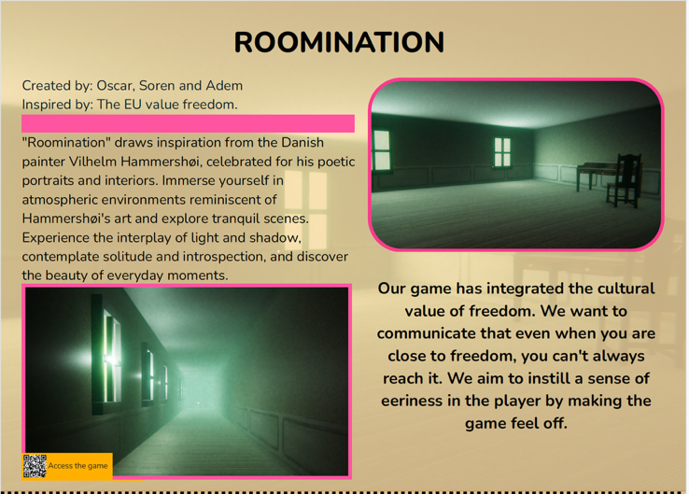
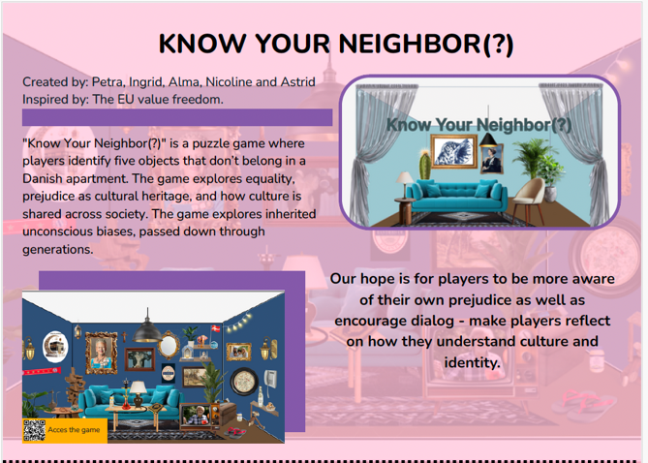
Cultural Game Jams creating
Games through / for Culture
Source material: Tangible & intangible cultural heritage as concrete game-making material, not ‘decoration’
Youth integrate cultural heritage & values into game mechanics, aesthetics, narratives, gameplay interactions & experiences to create innovative games through/for culture
CHI-CI practice site-centered empowered partnerships in Cultural Game Jams positioning game-making as culture-making
Promote societal transformation and cultural innovation through inviting players to explore to experience, manipulate, and extend tangible cultural heritage
Notes:
Games through culture often integrate tangible cultural heritage more or less directly (e.g. a ‘Hammershøj horror game’ or ’Goose on the loose’ that directly draw on a specific artworks at Aros).
They foreground tangible cultural heritage as playable resources.
Games for culture use game-making as a deliberate practice to explore, critique, and shape cultural values, social norms, identities, and civic imaginaries. They prioritize societal transformation, cultural dialogue, and empowerment, inviting players and creators to reflect on belonging, citizenship, and collective futures.
Mechanics and stories are crafted to surface dilemmas, contested histories, and cultural narratives – highlighting EU heritage & values as a driver for change, dialogue and ethics.
[evaluated by the game’s ability to…]

Slide 7
The current study

Slide 8
Research design
QUESTION: How do EPIC-WE games express youth’s engagement with different types of cultural heritage?
METHODS:
  Distant reading (focused on EU values)
  Close reading (including EU values
  but also using several analytical categories)
Notes:
We can read this research question backwards. We start with existing cultural heritage. It comes in different types, and young people engage with it in different ways. In the EPIC-WE project, this engagement is expressed through games, and we examine this expression.

Slide 9
Distant reading
EU value | Number of games | Percentage of all games | Example
Freedom | 51 | 44% | Roomination
Equality | 31 | 27% | Challenges
Human dignity | 19 | 16% | Terra Mater
Democracy | 17 | 15% | Blue Brigade
Rule of law | 9 | 8% | Art Parable
Human rights | 3 | 3% | He Must Be Fed

Slide 10
Close reading: Analytical categories
Source | Categories
UNESCO documents | Tangible heritage Intangible heritage
Critical heritage studies | Authorized heritage discourse Subaltern heritage discourses
Game studies | National heritage Regional heritage
Works related to the EPIC-WE project | Games through culture Games for culture

Slide 11
Close reading example: Art Parable (2024)
For the talk, we have picked a new example
(not from the full paper)
The game was made at the first Cultural Game Jam in Aarhus by Em Hansen, London Patterson, Niel Nielsen, and Marie Louise Bachmann
Free download: https://epic-we-resources.eu/game/1
What follows is Stanisław Krawczyk’s gameplay recording

Slide 12
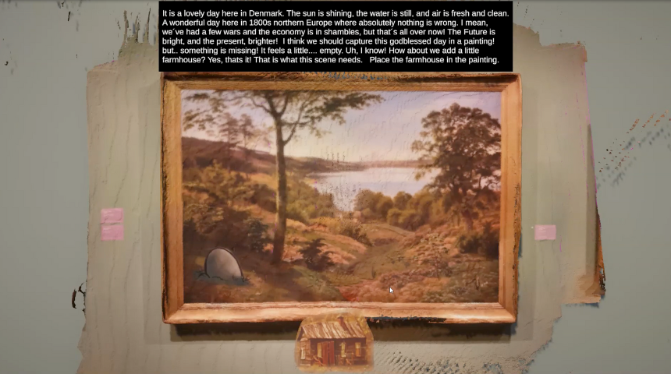

Slide 13
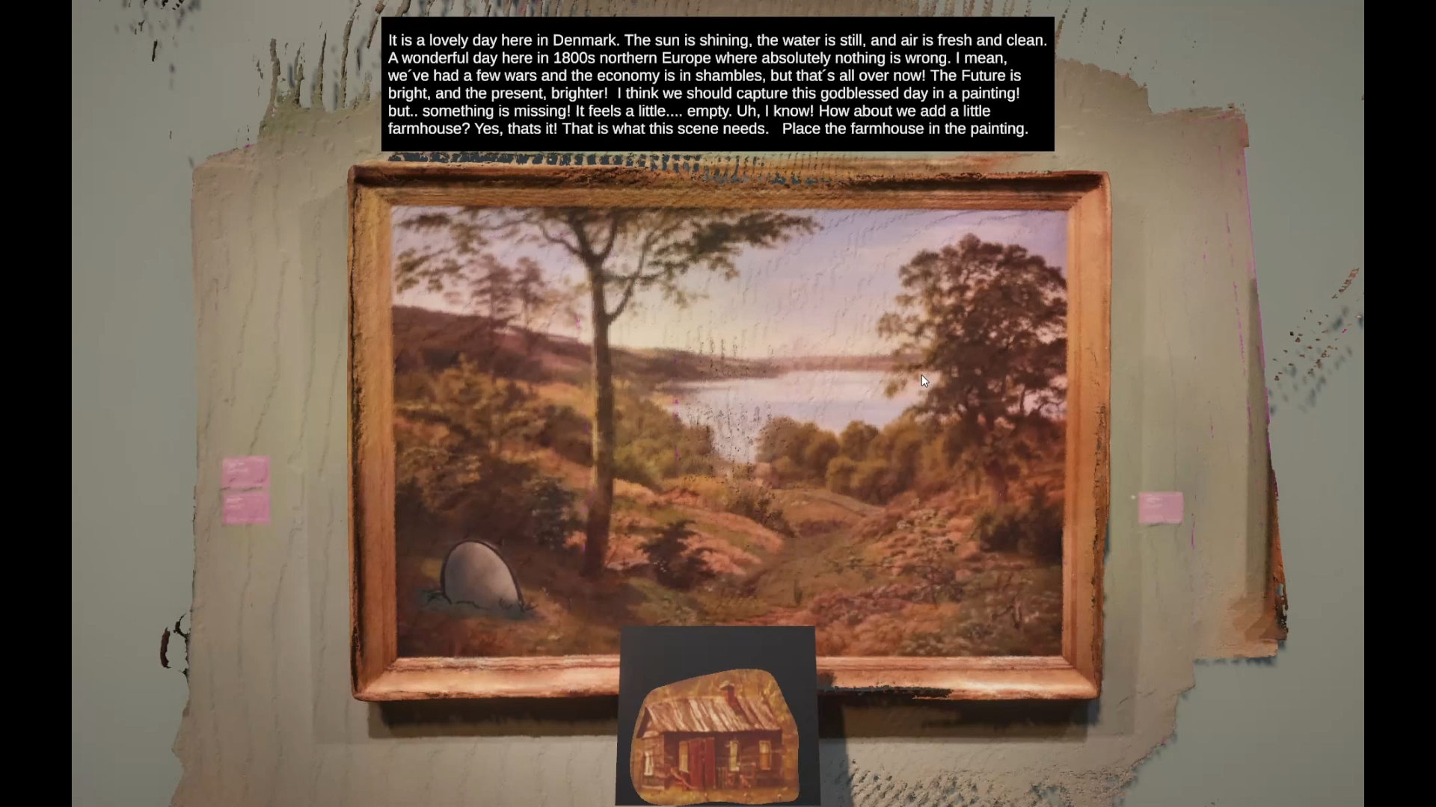

Slide 14
Art Parable analyzed
“Art Parable” recontextualizes Danish art from the 1800s . . . Re-create Vilhelm Kyhn’s “Vejle Fjord” with a modern twist, engaging with historical narratives and European values of freedom and law through interactive gameplay (https://epic-we-resources.eu/game/1)
Tangible heritage
National heritage & regional heritage
EU values
Authorized & subaltern heritage discourses
Game through & for culture

Slide 15
Full paper available online
https://stanislawkrawczyk.pl/ (the slides are also here)

Slide 16
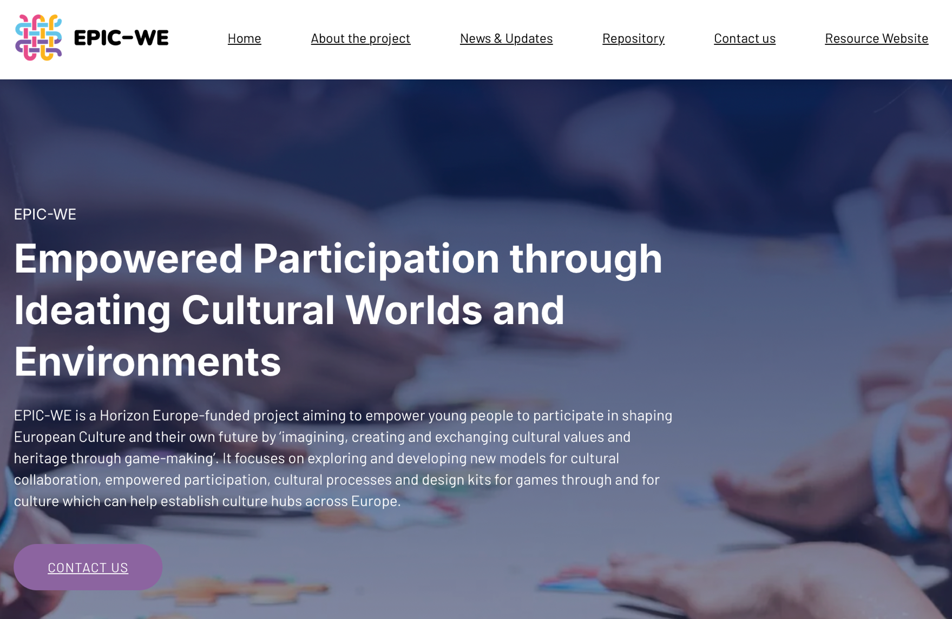
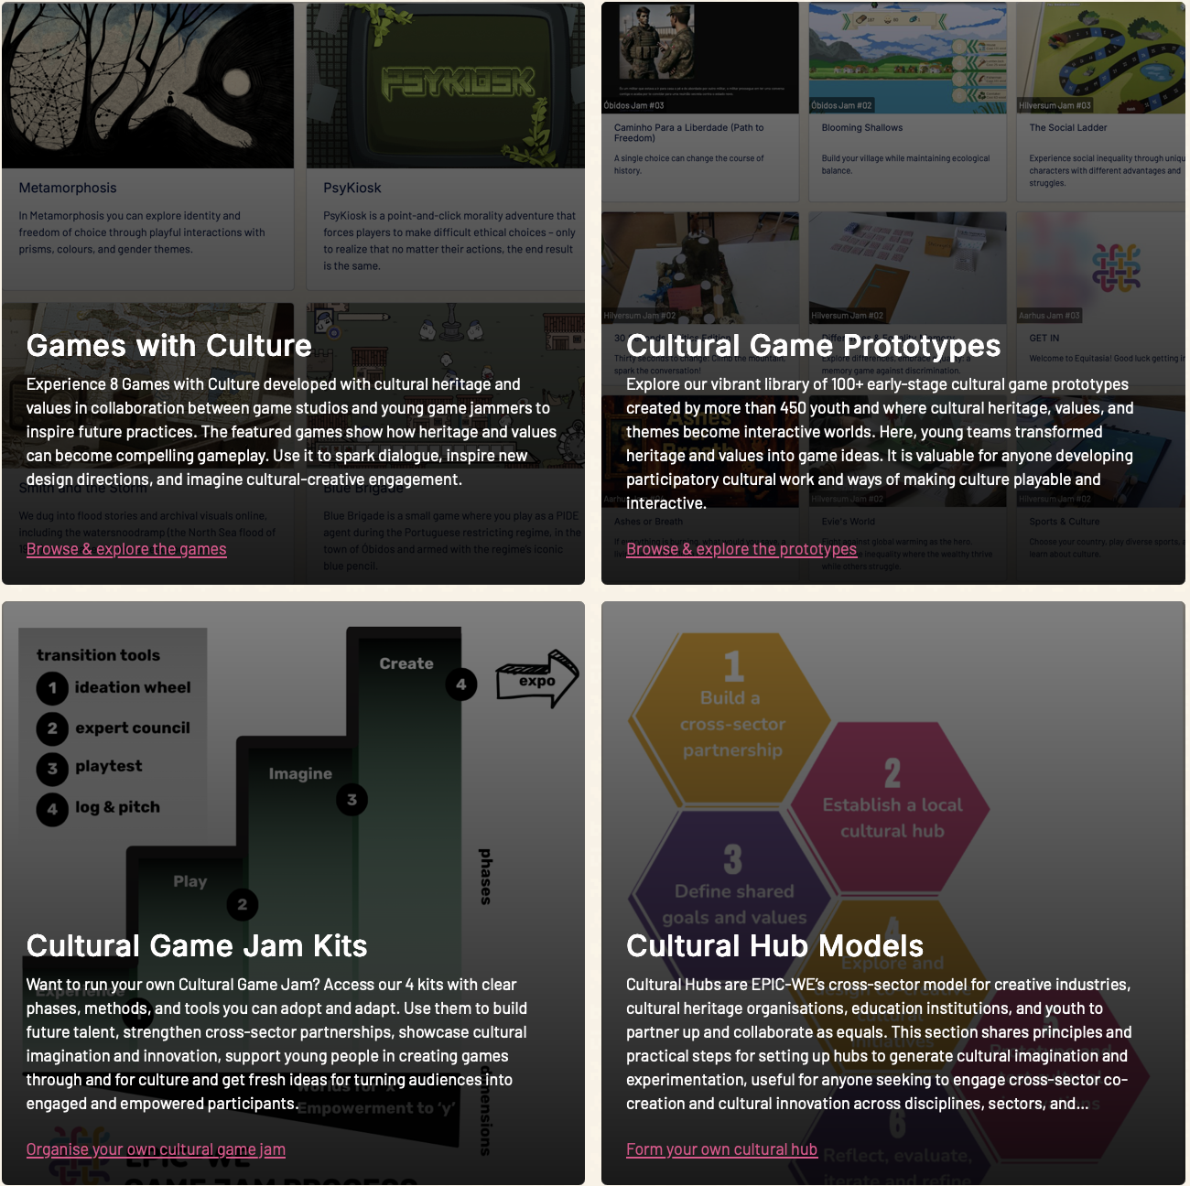

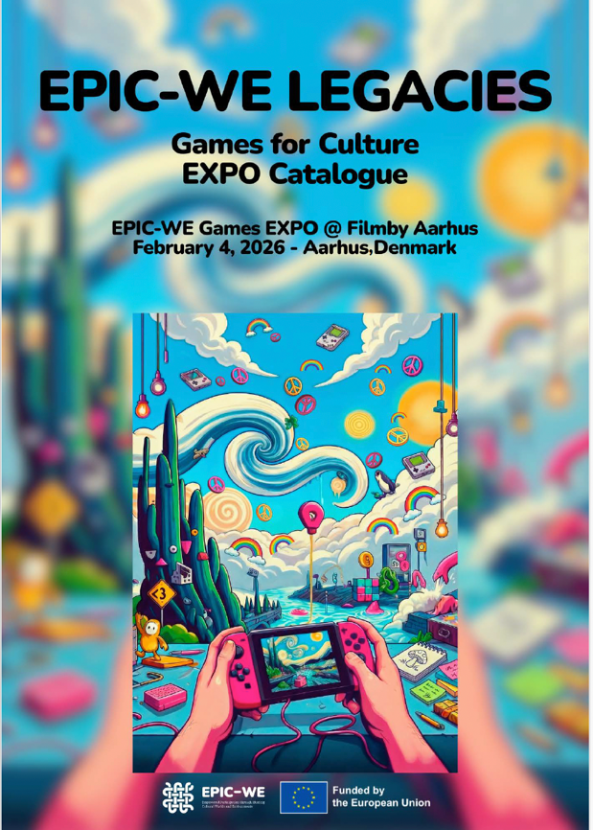
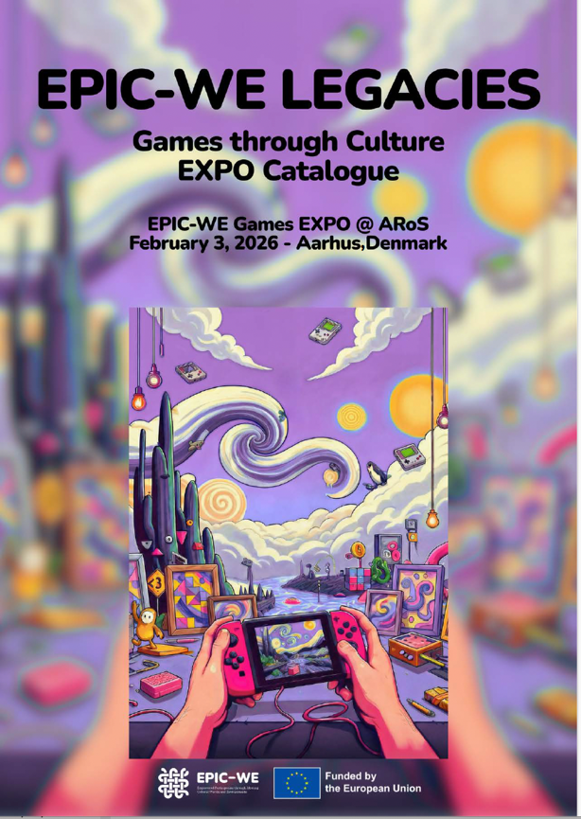
www.epic-we.eu
www.epic-we-resources.eu
Rikke Toft Nørgård
EPIC-WE Coordinator & Research Lead
Mail: rtoft@edu.au.dk
LinkedIn: Rikke Toft Nørgård
This project has received funding from the European Union’s Horizon Europe research and innovation programme under grant agreement No 101095058.

Slide 17
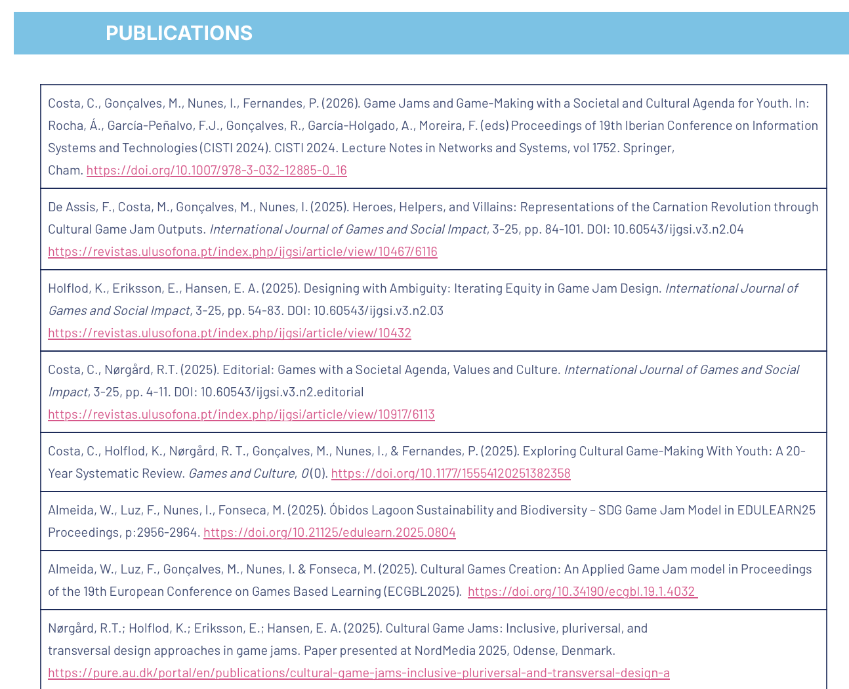
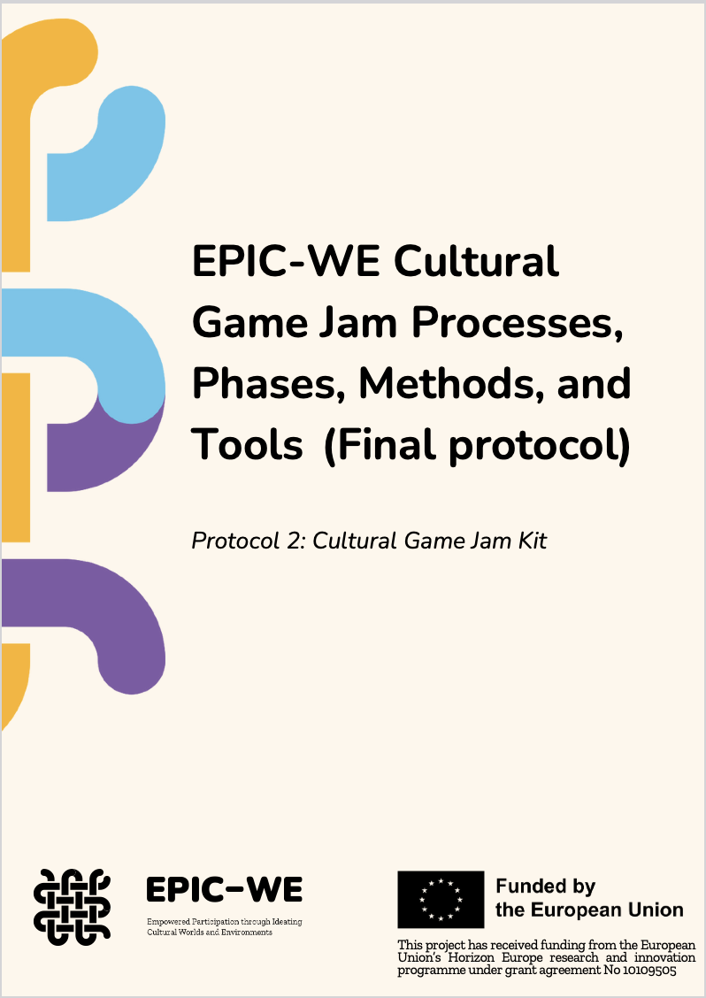
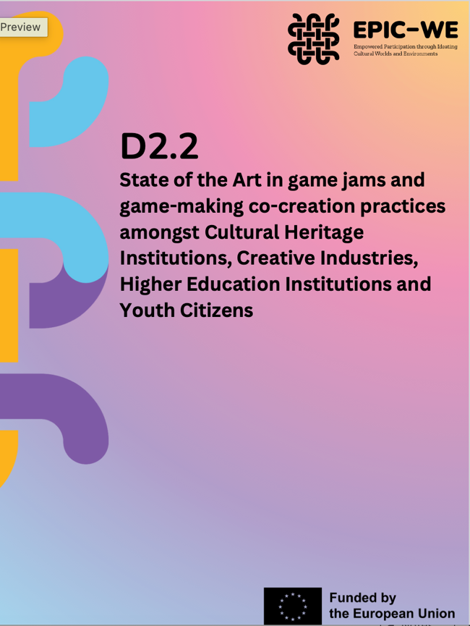
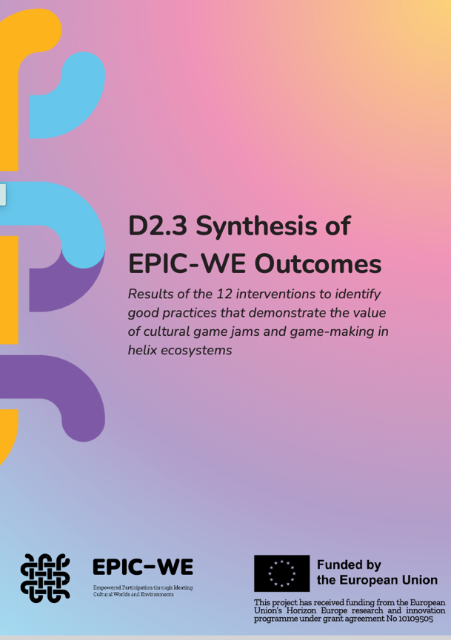
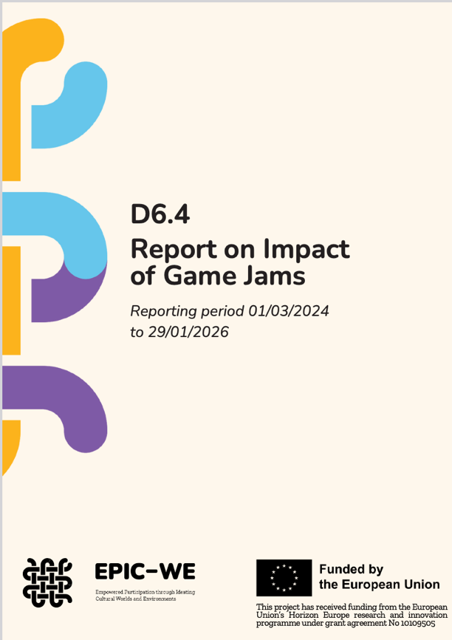
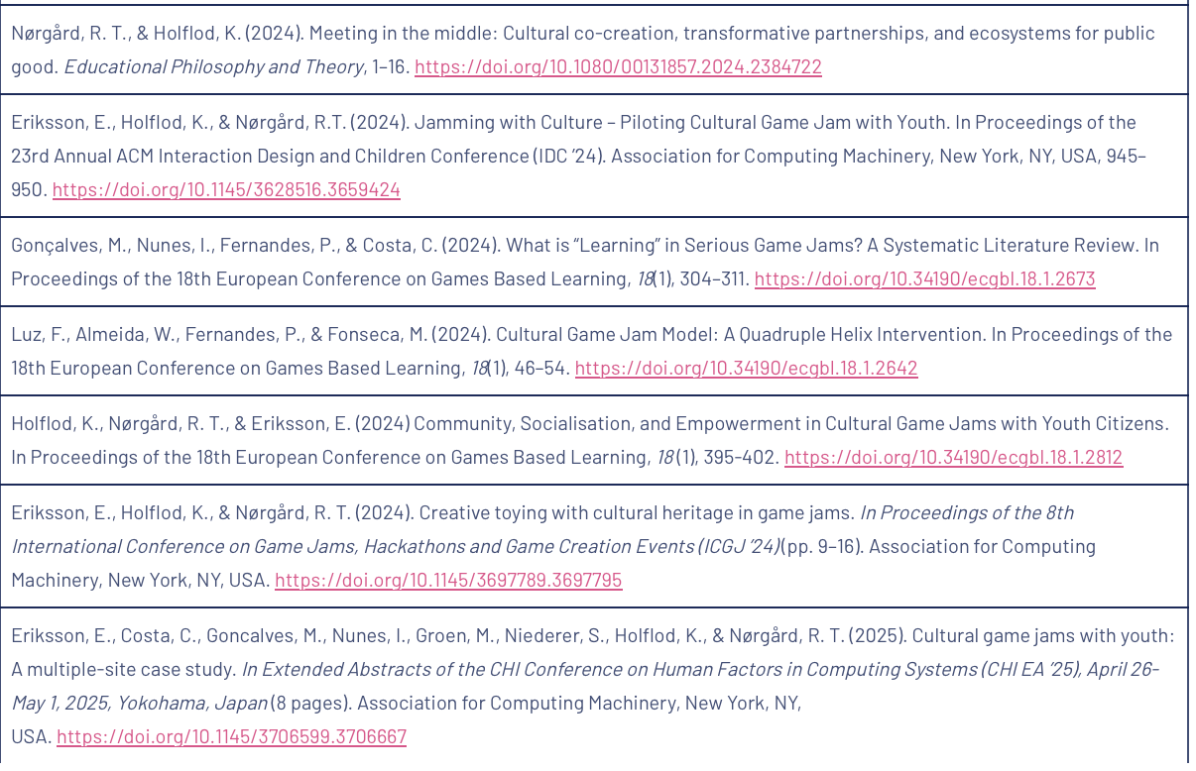
More EPIC-WE publications and reports available open access at project website

